Slide 1
Finding a Night Club Location in new YoRk
In the time of COVID using Data Science Techniques

Slide 2
Motivation

Slide 3
Data Acquisition and Cleaning
New York neighborhood data from Coursera assignment:
https://geo.nyu.edu/catalog/nyu_2451_34572
306 entries having latitude and longitude of geographical centers of neighborhoods
New York boundary data from geo json file:
https://github.com/veltman/snd3/blob/master/data/nyc-neighborhoods.geo.json
188 entries having the geographical boundaries of neighborhoods as polygons
Some neighborhoods were combined into single polygons
Foursquare API used to get Night Clubs based on distance from geographicl centers of neighborhoods

Slide 4
Club Locations and Neighborhood centers

Slide 5
Binning Clubs Geographically

Slide 6
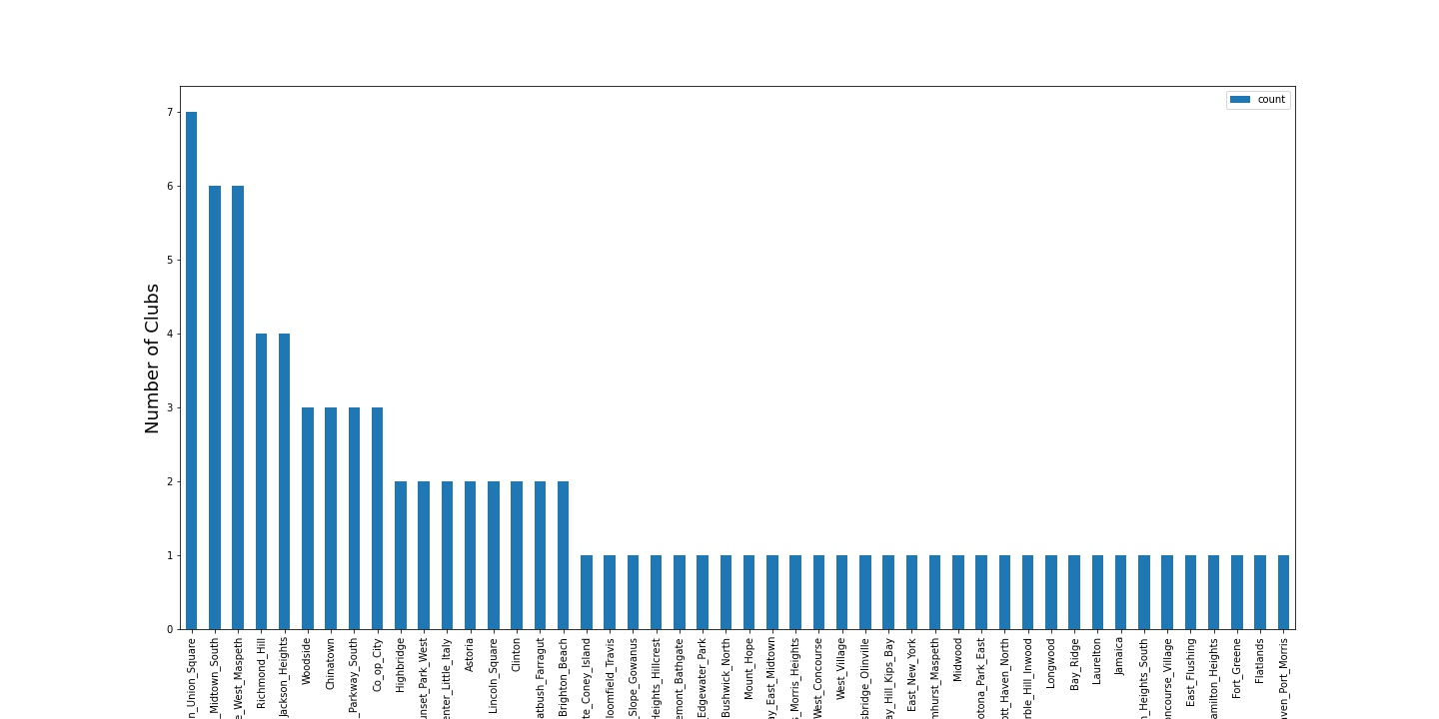
Choosing the Top Neighborhoods

Slide 7
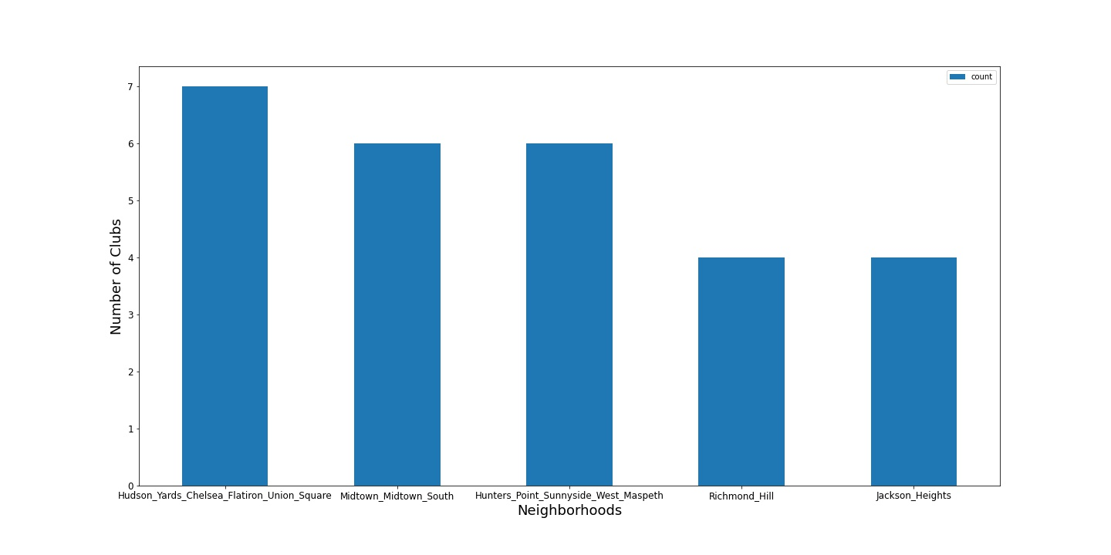
Five NeighBorhoods with the most clubs

Slide 8
Adding the Average Club Rating

Slide 9
Clustering by Location and Rating

Slide 10
Picking the best Neighborhood

Slide 11
Conclusion and Future Directions

